Slide 1





EMOTION RECOGNITION AND SENTIMENT ANALYSIS FOR RELATIONSHIP IMPROVEMENT
TMP-2023-24-133
Sri Lanka Institute of Information Technology

Slide 2

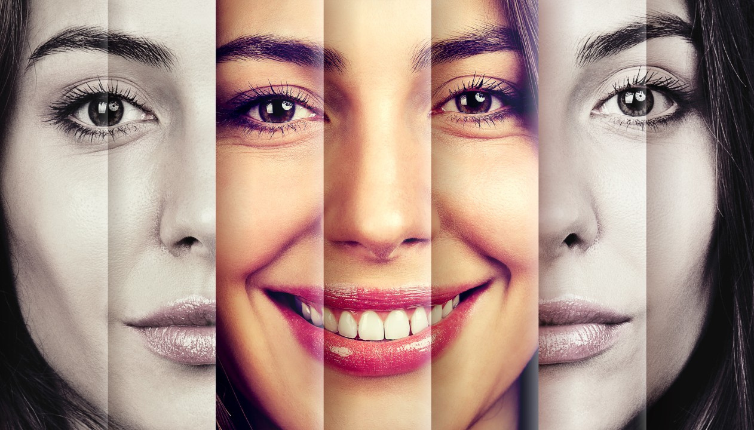
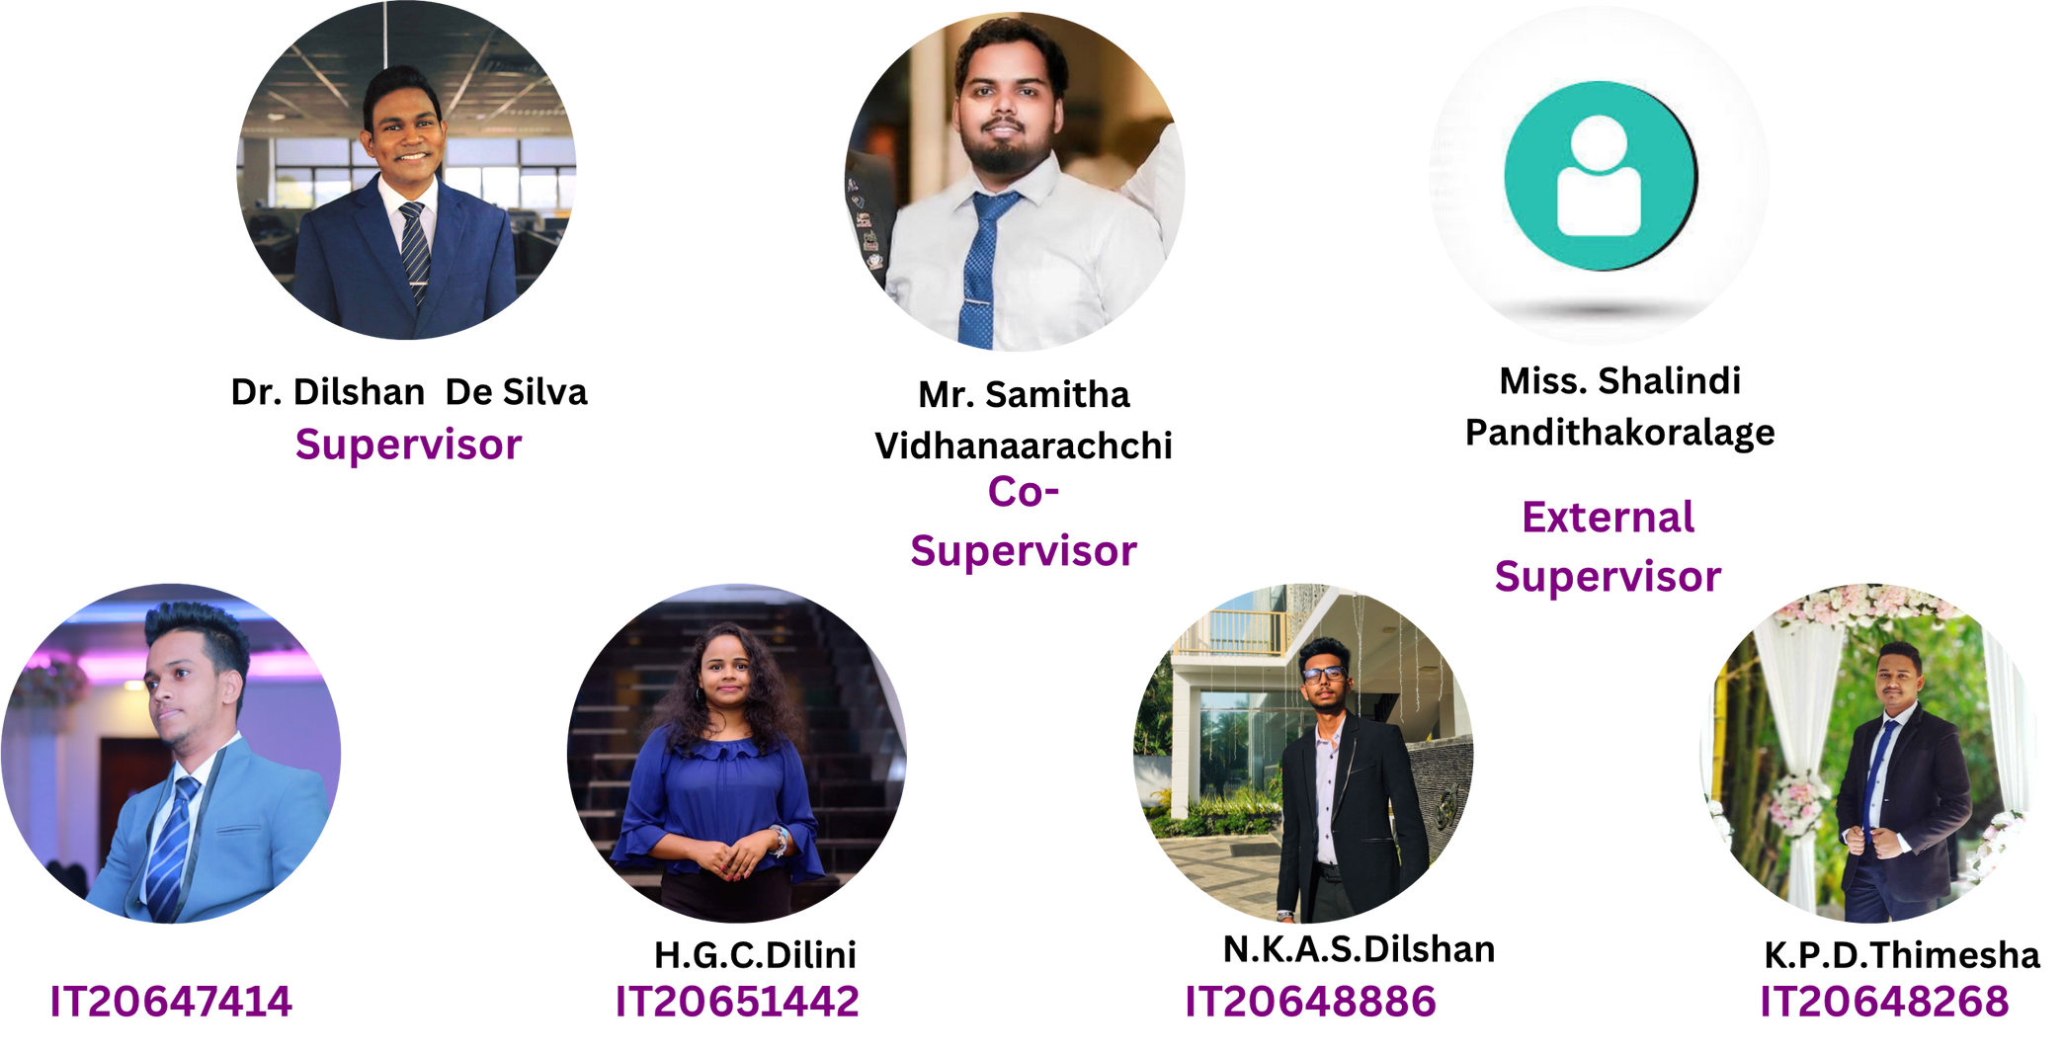
OUR TEAM

Slide 3
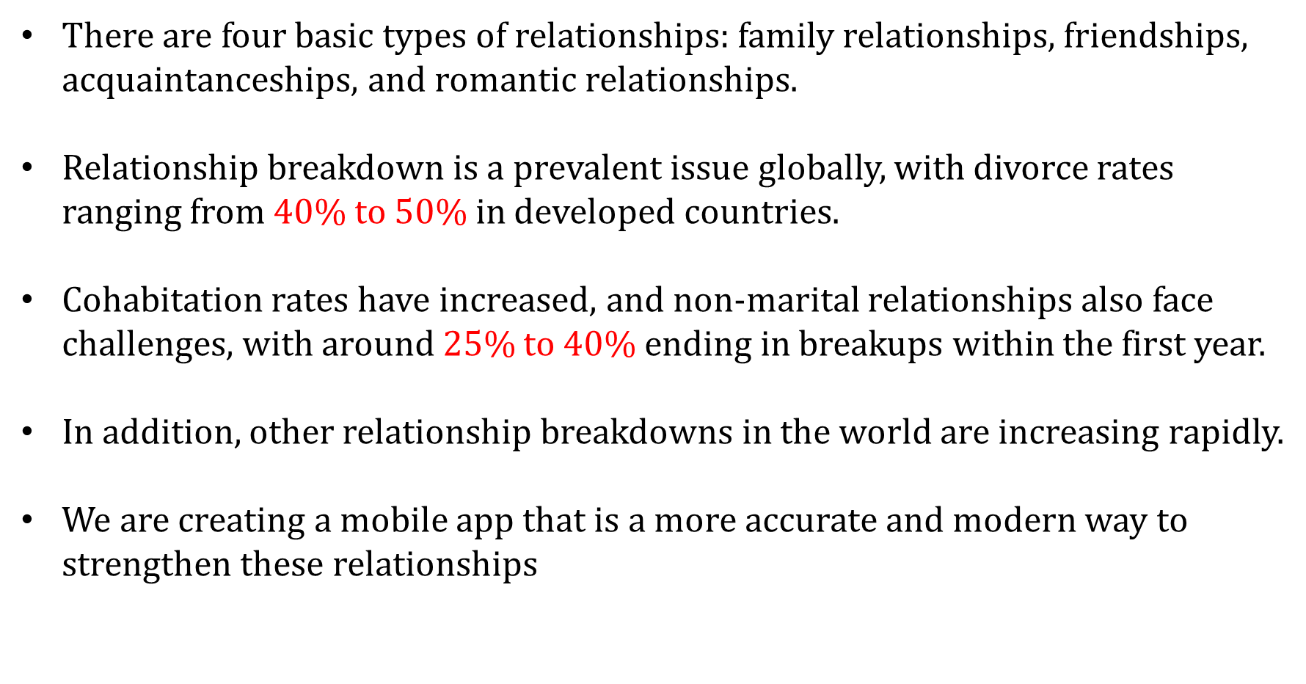
INTRODUCTION

Slide 4
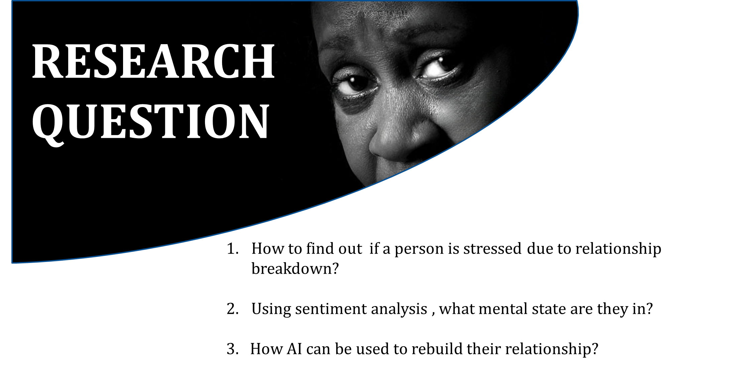

Slide 5
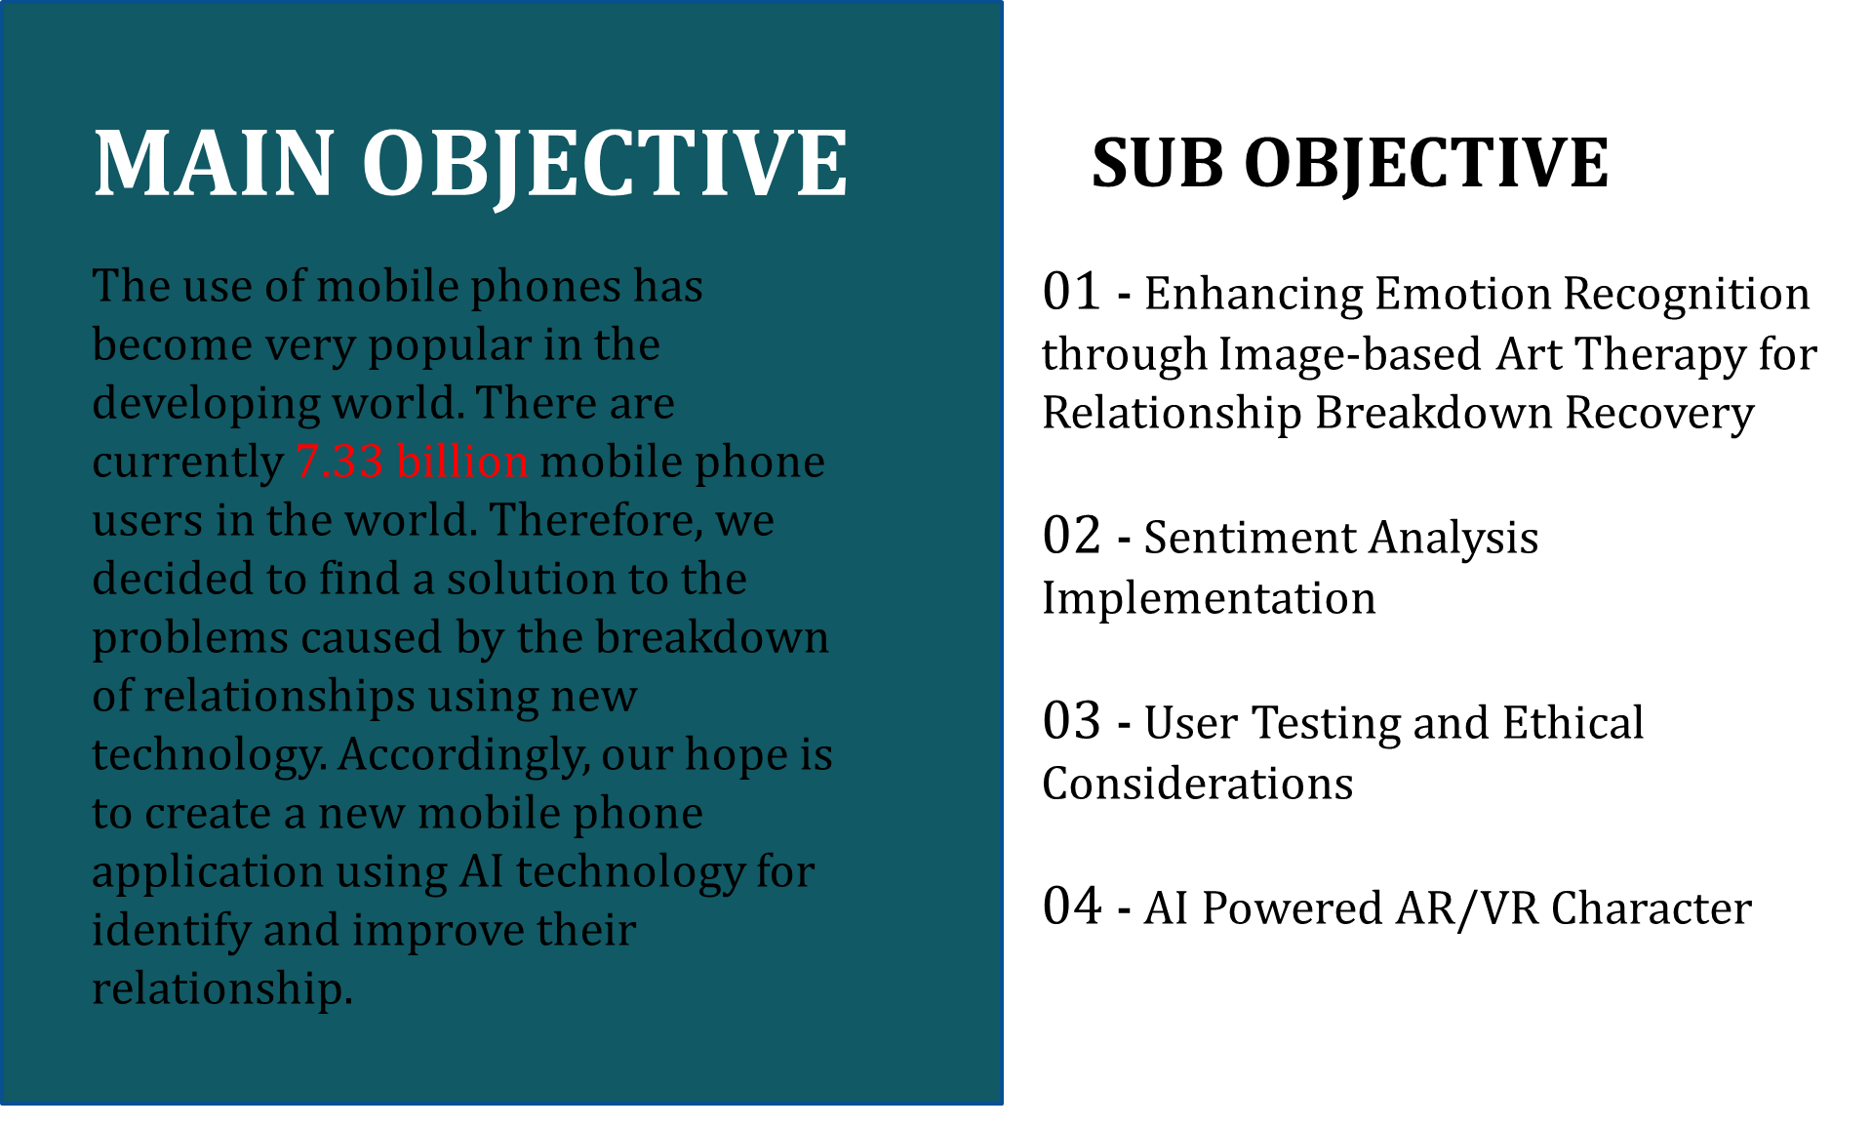

Slide 6
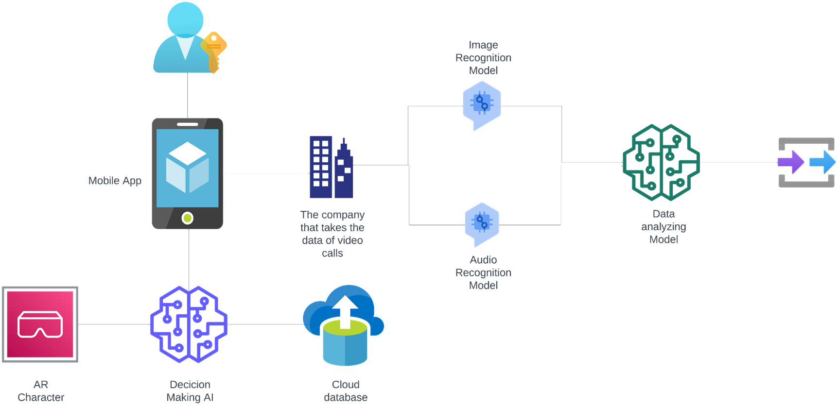
OVERALL SYSTEM DIAGRAM

Slide 7
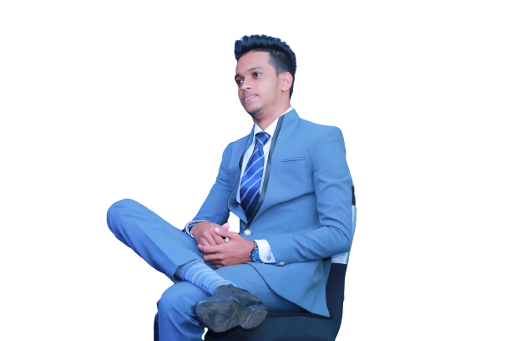

AYESH
BATADUWAARACHCHI
Specialization : Information Technology
IT20647414 | 2023-133
IT20647414 | BATADUWAARACHCHI A.I
2023-24-133 | 11/3/2023

Slide 8




RESEARCH QUESTION
How to start and maintain the good relationship?
How to deal with Emotions ?
How to provide social experiences for introverts and people who fear relationships.
IT20647414 | BATADUWAARACHCHI A.I
2023-24-133 | 11/3/2023

Slide 9



SPECIFIC AND SUB OBJECTIVE
01
Identifying the user's emotion level.
02
Identifying the user's Requirment level.
03
Provide the AR Training environment
04
Extract the training data and provide the available best solution
IT20647414 | BATADUWAARACHCHI A.I
2023-24-133 | 11/3/2023

Slide 10
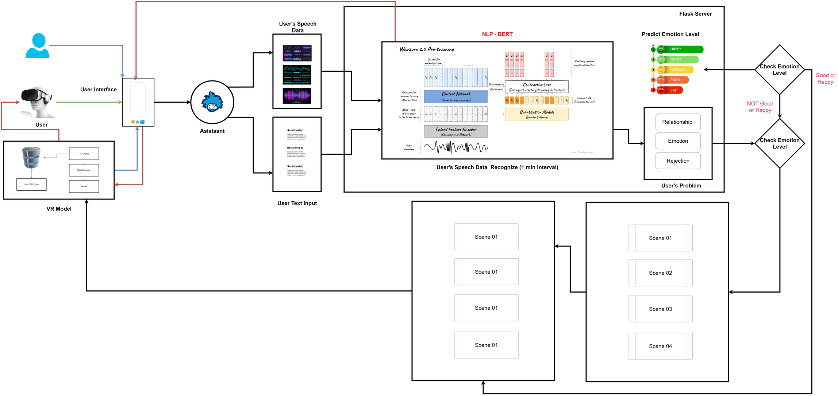
SYSTEM DIAGRAM
IT20647414 | BATADUWAARACHCHI A.I
2023-24-133 | 11/3/2023

Slide 11

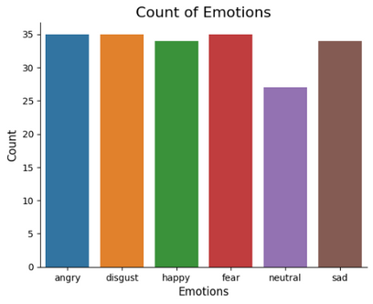
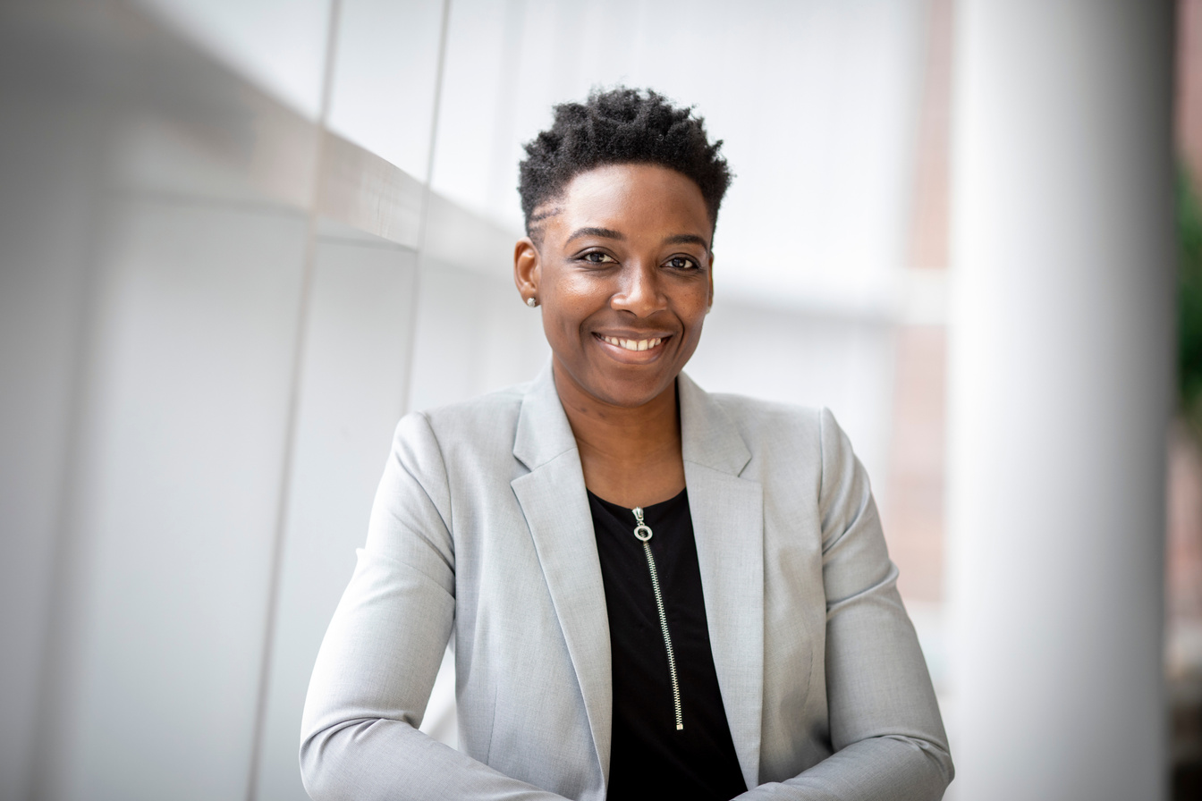
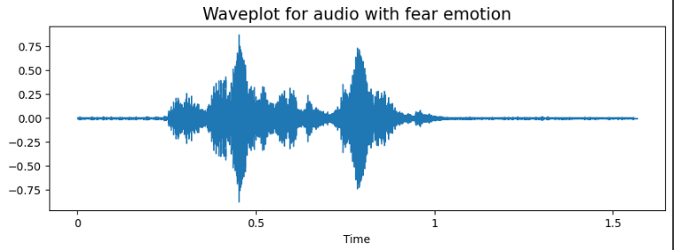
EVIDENCE OF COMPLETION
Data Collection, data pre-processing and data augmentation
Select the best NLP Model for accurate Emotion and User's Requirement
IT20647414 | BATADUWAARACHCHI A.I
2023-24-133 | 11/3/2023

Slide 12
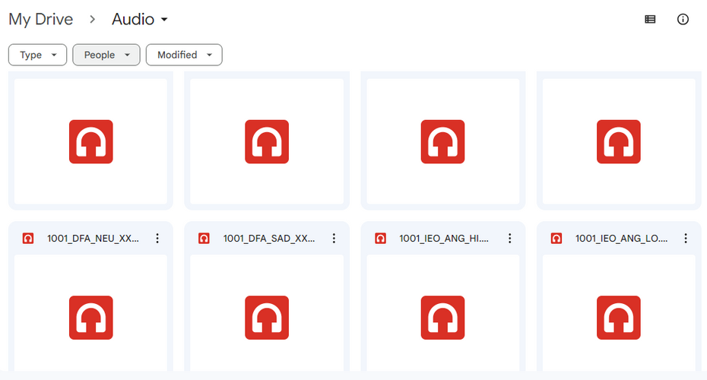
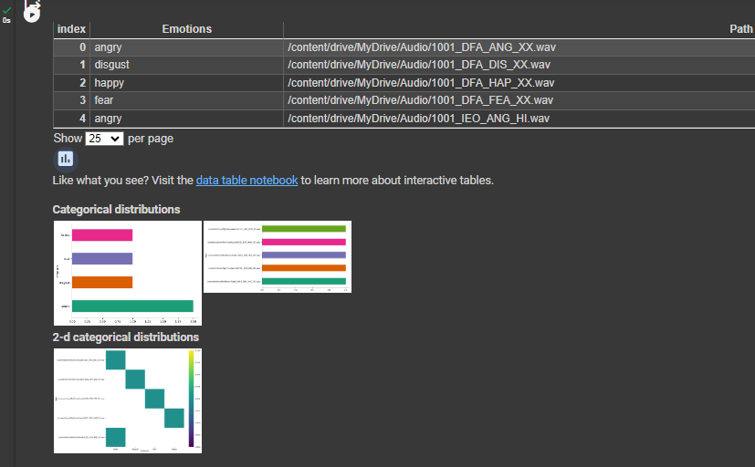
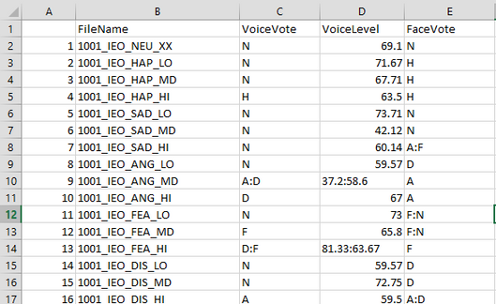
Sub Objective 01
Data collection
IT20647414 | BATADUWAARACHCHI A.I
2023-24-133 | 11/3/2023

Slide 13
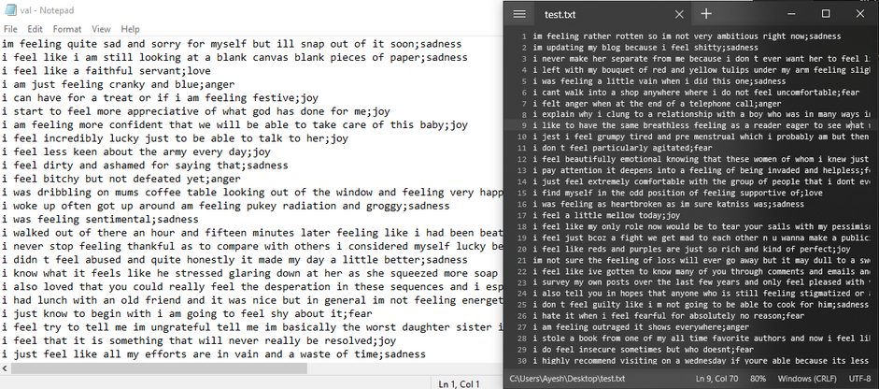
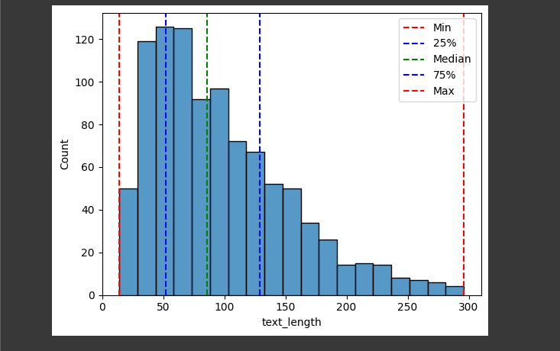
Data collection
Sub Objective 02
IT20647414 | BATADUWAARACHCHI A.I
2023-24-133 | 11/3/2023

Slide 14
Data collection and augmentation
Sub Objective 01
Augmentation
Pitch Changing
Noise Injection
Shifting
Stretching
IT20647414 | BATADUWAARACHCHI A.I
2023-24-133 | 11/3/2023

Slide 15
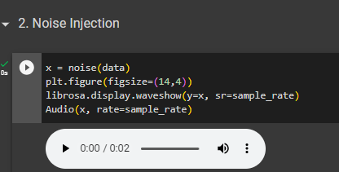
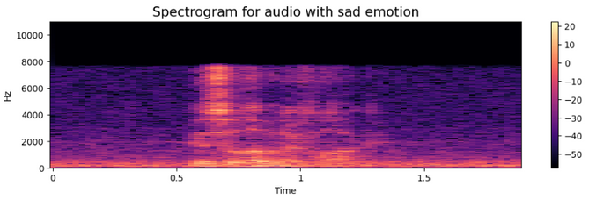
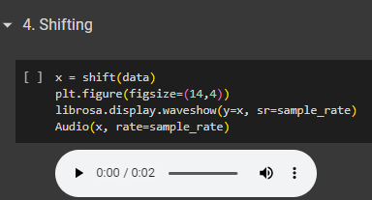
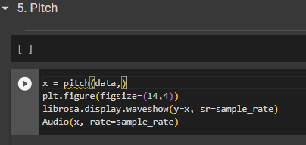
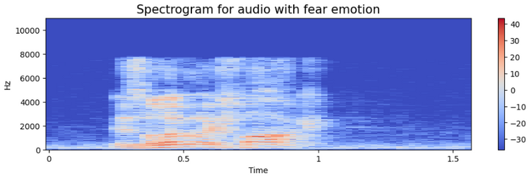
Data collection and augmentation
Sub Objective 01
IT20647414 | BATADUWAARACHCHI A.I
2023-24-133 | 11/3/2023

Slide 16
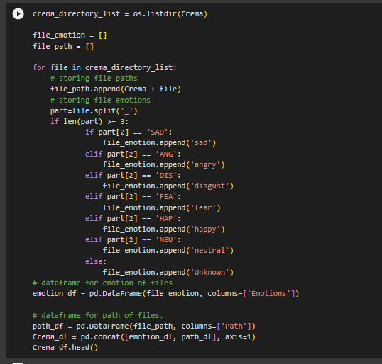
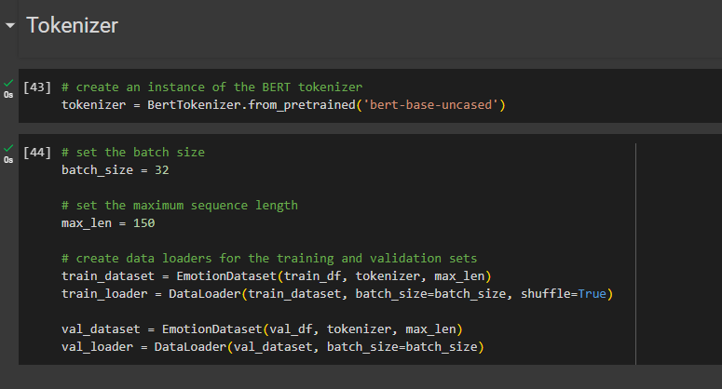
Data collection and pre-processing
Sub Objective 01
Sub Objective 02
IT20647414 | BATADUWAARACHCHI A.I
2023-24-133 | 11/3/2023

Slide 17
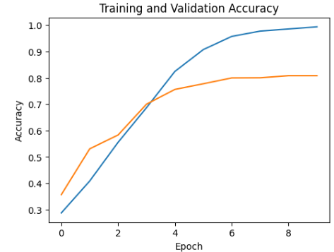
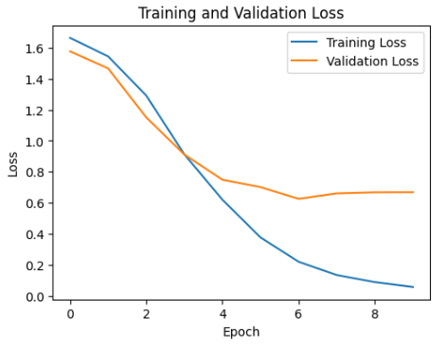
Data collection and Data visualization
Training and validation Accuracy (NLP Model)
Training and validation lost
(NLP Model)
IT20647414 | BATADUWAARACHCHI A.I
2023-24-133 | 11/3/2023

Slide 18




Completion and Future works
Completion of the components
Identifying the user's emotion level.
Identifying the user's Requirement
90%
80%
86%
IT20647414 | BATADUWAARACHCHI A.I
2023-24-133 | 11/3/2023

Slide 19


Completion and Future works
Future Implementation
Create User Assistance
Provide the AR Training environment
10%
25%
15%
IT20647414 | BATADUWAARACHCHI A.I
2023-24-133 | 11/3/2023

Slide 20
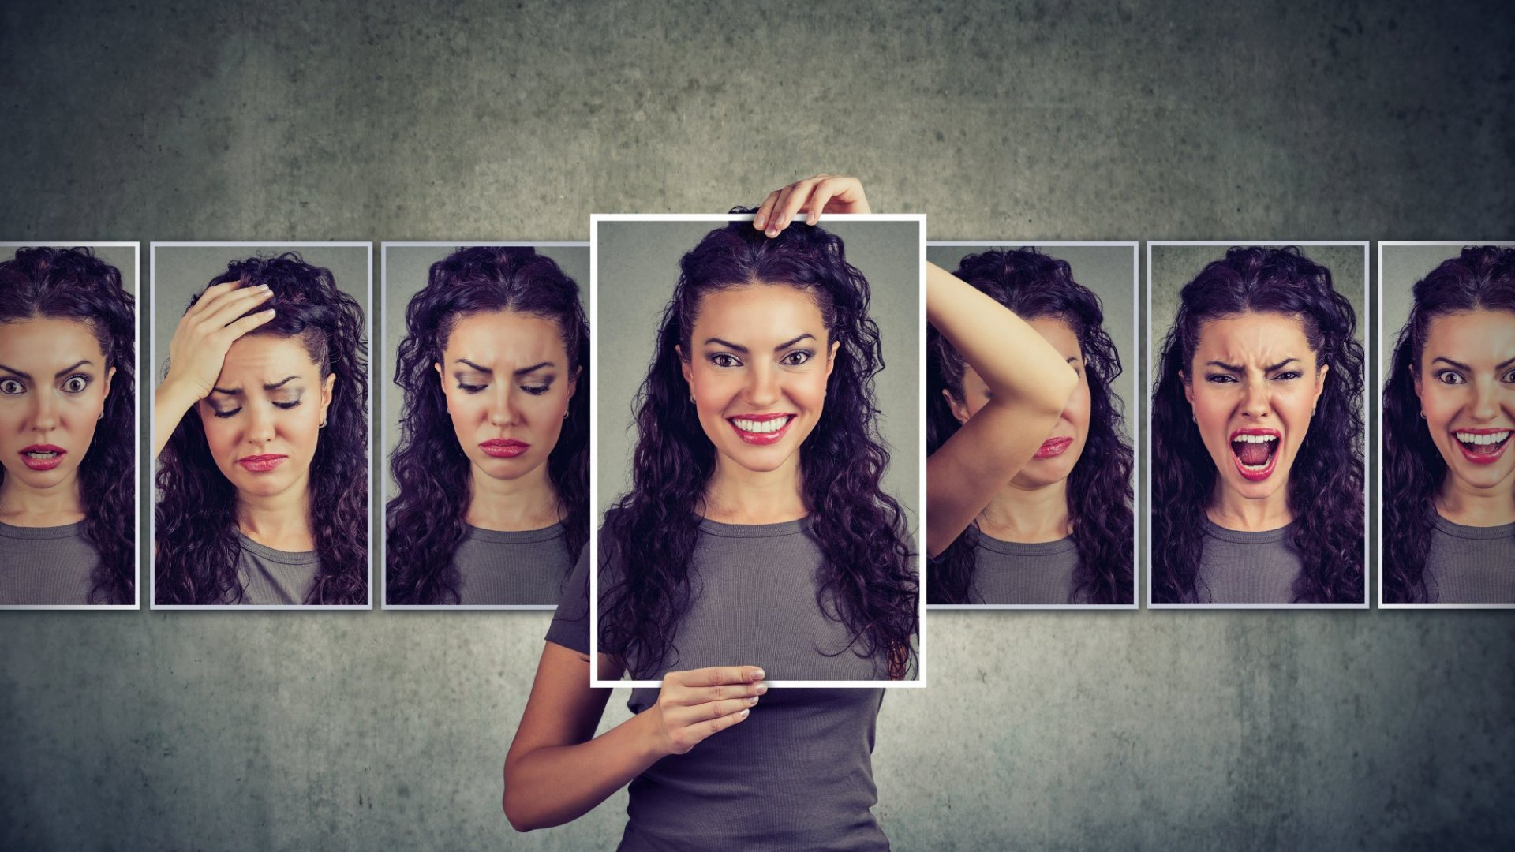
TECHNOLOGIES, TECHNIQUES AND ALGORITHMS
Technologies
Techniques
Algorithms
React Native
Python
Google Colab
Flask Server
Node Server
Intellij Idea
Blender
Unity 3D
VR/AR
Data Augmentation
Data preprocessing
Data Visualization
Character Animation
NLP algorithms
IT20647414 | BATADUWAARACHCHI A.I
2023-24-133 | 11/3/2023

Slide 21
SYSTEM, PERSONNEL, AND SOFTWARE SPECIFICATION REQUIREMENTS
Functional Requirements
Identify the User's Emotion
Properly.
Identify the user's requirements
very accurately.
The assistant needs to navigate
the user to the correct scenario.
VR Environment should be very Accurate.
Non-Functional Requirements
Mobile Interface should be user friendly.
Support All type of VR Headset.
Support All Android and IOS mobile.
Training Environment should be accurate and user friendly.
IT20647414 | BATADUWAARACHCHI A.I
2023-24-133 | 11/3/2023

Slide 22
SYSTEM, PERSONNEL, AND SOFTWARE SPECIFICATION REQUIREMENTS
Software Requirements
Jupyter Notebook
Visual Studio Code
Intellij Idea
Blender
Unity 3D
Non-Functional Requirements
Forum on Mental Health
Ms. SachiniPathiraja(Psychologist, BSc Psy (US), Grad Dip (AUS))
SLIIT Helping Hands.
IT20647414 | BATADUWAARACHCHI A.I
2023-24-133 | 11/3/2023

Slide 23
REFERENCES
S. Holt, “Virtual reality, augmented reality and mixed reality: For astronaut mental health; and space tourism, education and outreach,” Acta Astronautica, Dec. 2022, doi:
[2]
K.-Y. Wang, A. R. Ashraf, Narongsak Tek Thongpapanl, and O. Nguyen, “Influence of social augmented reality app usage on customer relationships and continuance intention: The role of shared social experience,” vol. 166, pp. 114092–114092, Nov. 2023, doi:
[3]
H. Kumar and A. Martin, “Artificial Emotional Intelligence: Conventional and Deep learning Approach,” Expert Systems with Applications, p. 118651, Aug. 2022, doi:
[4]
A. J. Horn and C. S. Carter, “Love and longevity: A Social Dependency Hypothesis,” Comprehensive Psychoneuroendocrinology, vol. 8, p. 100088, Nov. 2021, doi:

Slide 24

DILSHAN
N . K . A . S
Specialization : Information Technology
IT20648886 | 2023-133
IT20648886 | DILSHAN N.K.A.S
2023-24-133 | 11/3/2023

Slide 25
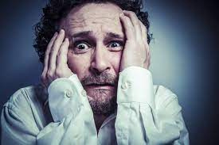



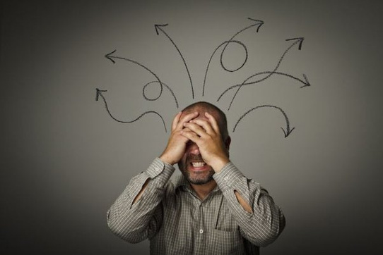

BACKGROUND
Emotions play a fundamental role in human relationships[2], influencing communication, understanding, and overall satisfaction.
relationship breakdowns can make serious mental health issues[1] and there is no platform for get help until meet a professional counselor or doctor.
IT20648886 | DILSHAN N.K.A.S
2023-24-133 | 11/3/2023

Slide 26
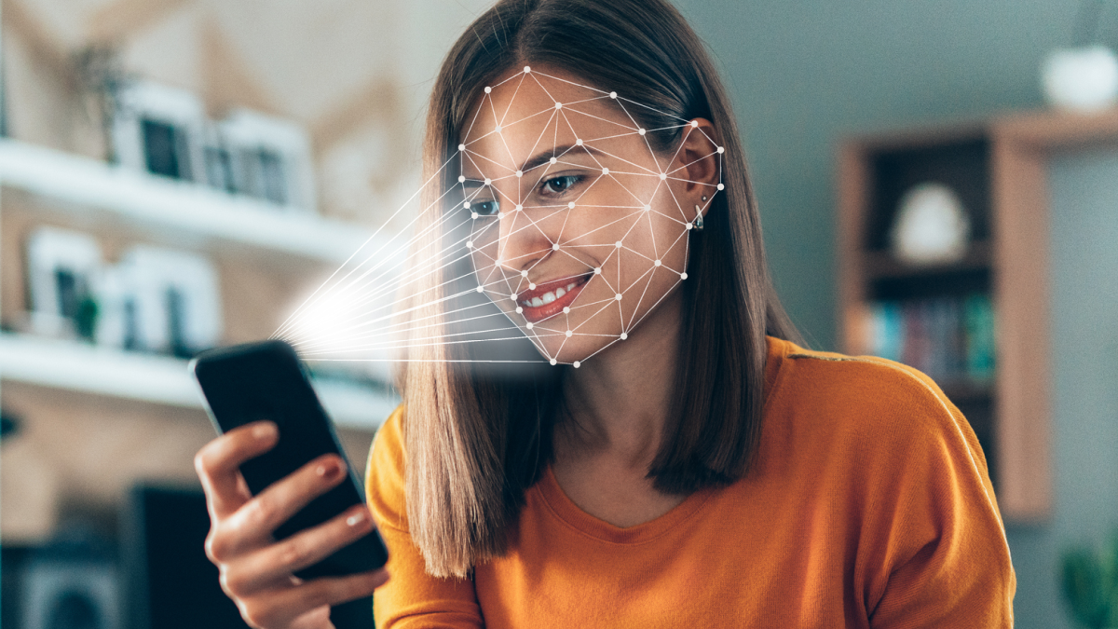

RESEARCH QUESTION
Identifying user mental
state and giving them a advise
Using voice recognition models output data as input to analysis model identifying user mental state.
Using analysis model outputs give the advise and suggest the games for user.
How to provide social experiences for introverts and people who fear relationships.
IT20648886 | DILSHAN N.K.A.S
2023-24-133 | 11/3/2023

Slide 27
SPECIFIC AND SUB OBJECTIVE
01
Analise the users mood using Neural Network Classification.
02
Suggest the best advice for the users mood state.
03
Suggest the game for user to maintain users focus level.
03
Make mobile application to show the advises and suggest a games.
IT20648886 | DILSHAN N.K.A.S
2023-24-133 | 11/3/2023

Slide 28
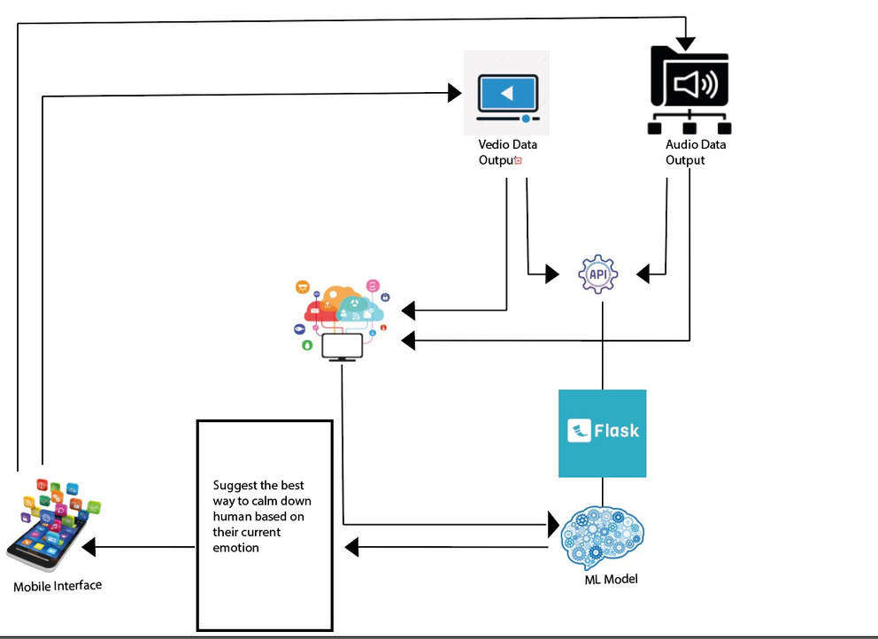
SYSTEM DIAGRAM
IT20648886 | DILSHAN N.K.A.S
2023-24-133 | 11/3/2023

Slide 29
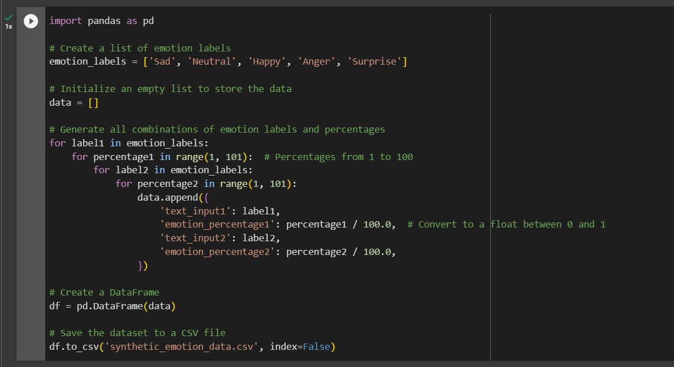
EVIDENCE OF COMPLETION
DATA GATHERING
For this part there are no data set to find from sources. So this sample data set is hard coded using python code.
IT20648886 | DILSHAN N.K.A.S
2023-24-133 | 11/3/2023

Slide 30
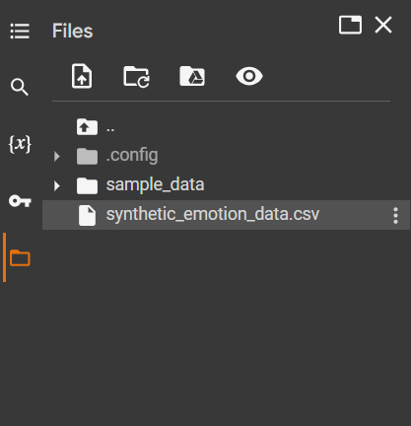
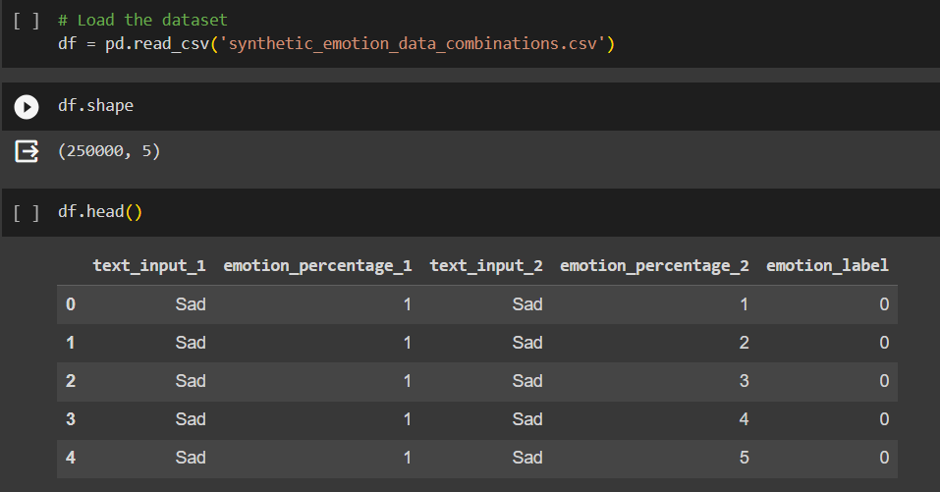
EVIDENCE OF COMPLETION
DATA GATHERING
Created dataset
IT20648886 | DILSHAN N.K.A.S
2023-24-133 | 11/3/2023

Slide 31
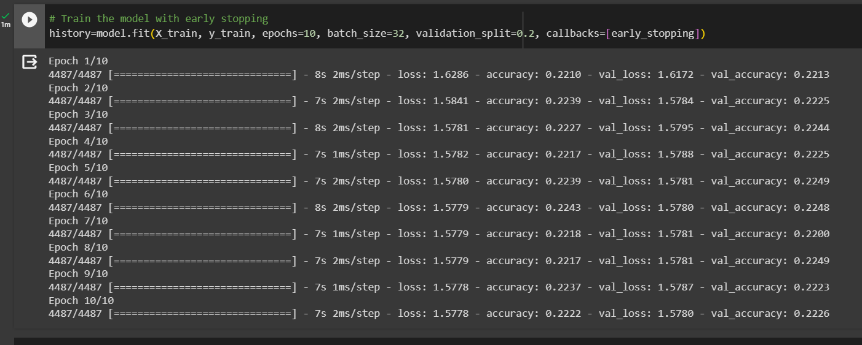
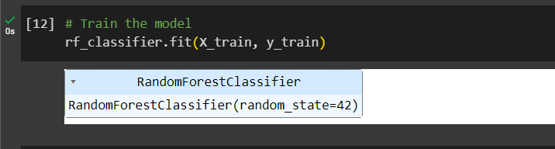
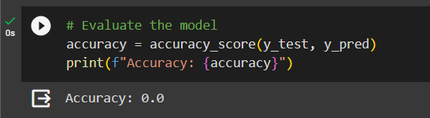
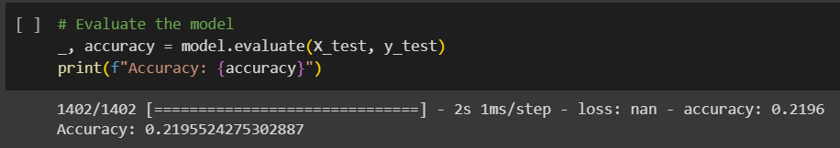
EVIDENCE OF COMPLETION
MODEL ARCHITECTURES
Neural Network
Random Forest
IT20648886 | DILSHAN N.K.A.S
2023-24-133 | 11/3/2023

Slide 32
EVIDENCE OF COMPLETION
DATA PREPROCESSING
Overall, this data preprocessing part involves loading the dataset, mapping text-based labels to numerical values, extracting features and labels, and encoding the labels to prepare the data for training a machine learning model.
IT20648886 | DILSHAN N.K.A.S
2023-24-133 | 11/3/2023

Slide 33
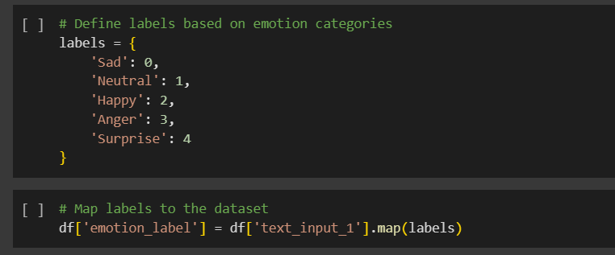
EVIDENCE OF COMPLETION
DATA PREPROCESSING
Mapping text-based labels to numerical values
IT20648886 | DILSHAN N.K.A.S
2023-24-133 | 11/3/2023

Slide 34
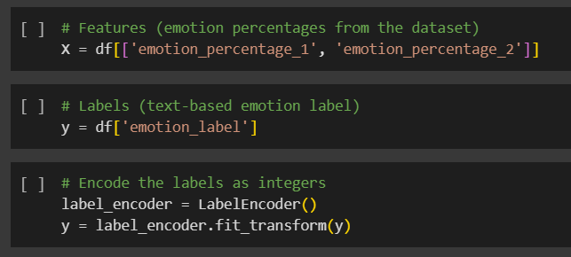
EVIDENCE OF COMPLETION
DATA PREPROCESSING
Extracting features and labels.
IT20648886 | DILSHAN N.K.A.S
2023-24-133 | 11/3/2023

Slide 35
EVIDENCE OF COMPLETION
MODEL TRAINING
Model training using Feedforward Neural Network .
IT20648886 | DILSHAN N.K.A.S
2023-24-133 | 11/3/2023

Slide 36
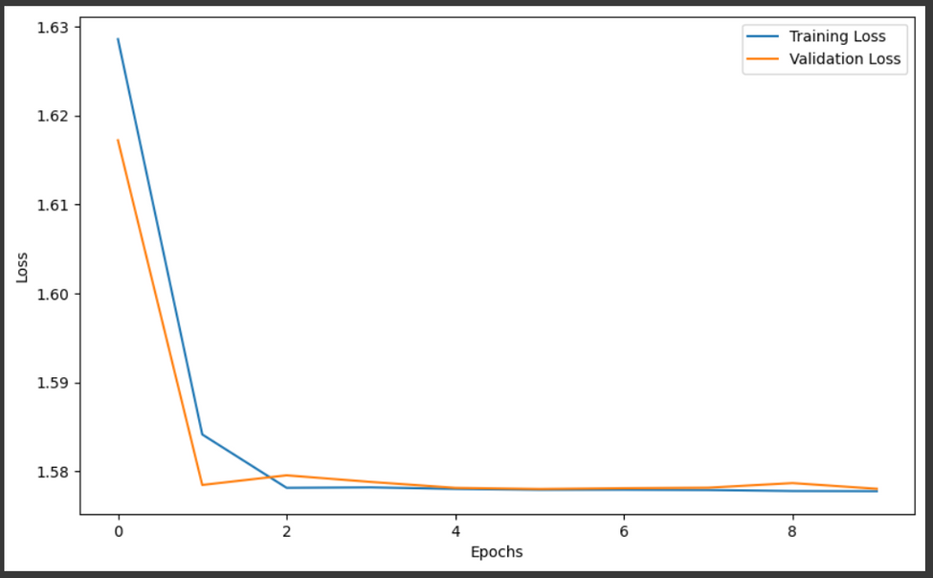
EVIDENCE OF COMPLETION
MODEL TRAINING
Training Lost
Validation Lost
IT20648886 | DILSHAN N.K.A.S
2023-24-133 | 11/3/2023

Slide 37

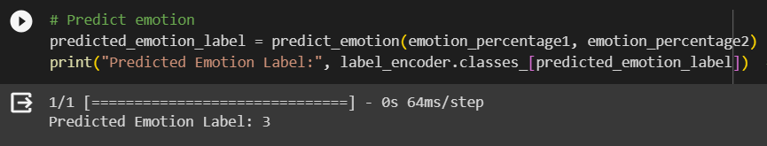
EVIDENCE OF COMPLETION
IDENTIFY MOOD OF USER
For testing purposes I’m getting input using consol.
IT20648886 | DILSHAN N.K.A.S
2023-24-133 | 11/3/2023

Slide 38
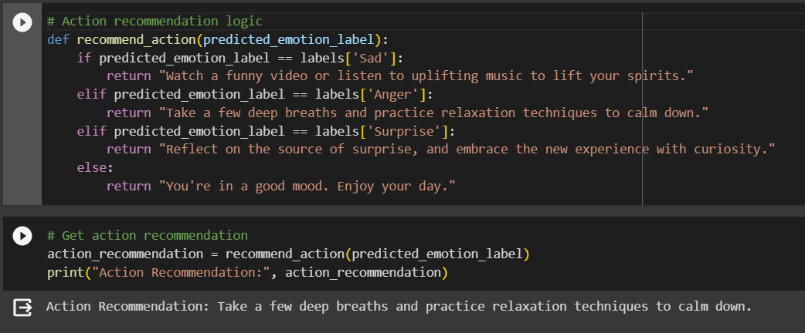
EVIDENCE OF COMPLETION
SUGGEST AN ADVISE FOR USER
Action recommendation for user.
IT20648886 | DILSHAN N.K.A.S
2023-24-133 | 11/3/2023

Slide 39
COMPLETION AND FUTURE WORKS
Completion
Future Implementation
Getting input from image processing and voice recognition models outputs(until them full complete their models input get using keyboard)
Identify users emotion mood state.
Giving advise for users.
Finalize and testing the analyze model after image and voice recognition models complete.
display result and game level suggestions in mobile application.
55%
45%
IT20648886 | DILSHAN N.K.A.S
2023-24-133 | 11/3/2023

Slide 40




SYSTEM AND SOFTWARE SPECIFICATION REQUREMENTS
Functional Requirements
Non-functional Requirements
System Requirement
Calming and attractive user-friendly interface
The application should properly work for cross platform.
Application should provide fast result
Higher accuracy of results
Result should be more efficient
The system should identify the users mood state for further steps
The advise for the user should be shown
What level of game should suggest for the user
Tensorflow & keras
Flask server to run the models
Google colab
Visual studio code
IT20648886 | DILSHAN N.K.A.S
2023-24-133 | 11/3/2023

Slide 41
TECHNOLOGIES AND TECHNIQUES
Technologies
Algorithms
Techniques
Feedforward Neural Network
React Native
Python
Flask server
VS code
Tensor flow
Keras
ReLU
Adam Optimizer
EarlyStopping
IT20648886 | DILSHAN N.K.A.S
2023-24-133 | 11/3/2023

Slide 42
REFFERENCES
[1]Galena K. Rhoades,* Claire M. Kamp Dush, David C. Atkins, Scott M. Stanley, and Howard J. Markman
“Breaking Up is Hard to do: The Impact of Unmarried Relationship Dissolution on Mental Health and Life Satisfaction” J Fam Psychol. 2011 Jun; 25(3): 366–374.
[2]Ankit Chandra Pragyan Paramita Parija
“The Love - Breakup study: Defining love and exploring reasons
for the breakup of romantic relationships” Volume (7), Issue (2), December 2021
IT20648886 | DILSHAN N.K.A.S
2023-24-133 | 11/3/2023

Slide 43
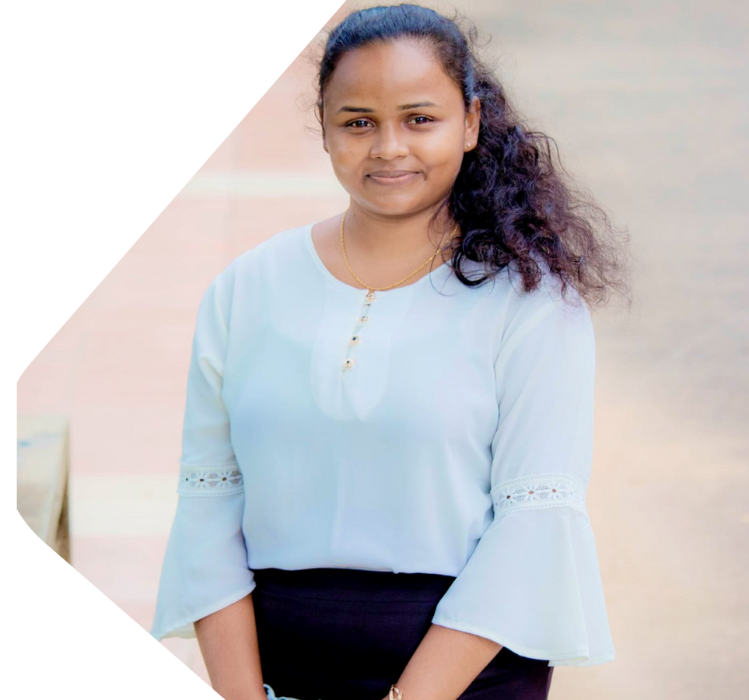
DILINI
GAMAGE
Specialization : Information Technology
IT20651442 | 2023-133
IT20651442 | Dilini. H.G.C
2023-24-133 | 11/3/2023

Slide 44
BACKGROUND & RESEARCH PROBLEM
Relationship breakdowns, like friendships and family issues, happen often in worldwide.
The culture and traditions impact how people handle relationships.
These breakdowns affect people emotionally and can influence society.
This component focuses on accurately recognizing human emotions, particularly through facial expressions, to address various real-world needs.
IT20651442 | Dilini. H.G.C
2023-24-133 | 11/3/2023

Slide 45
RESEARCH QUESTION
How to identify the user emotions?
Emotions are complex and can change over time.
Image processing can capture the user's facial expressions and emotions but may not provide a fixed emotional state.
.
Therefore, we collect the number of blinks, body movements and behavior of the relevant person in relation to the relevant frames.
IT20651442 | Dilini. H.G.C
2023-24-133 | 11/3/2023

Slide 46
SPECIFIC AND SUB OBJECTIVE
01
Implementation of a method to collect data through video call feed.
02
Develop an emotion recognition model.
03
Train the model using the dataset.
03
Goal tracking and emotional growth.
IT20651442 | Dilini. H.G.C
2023-24-133 | 11/3/2023

Slide 47
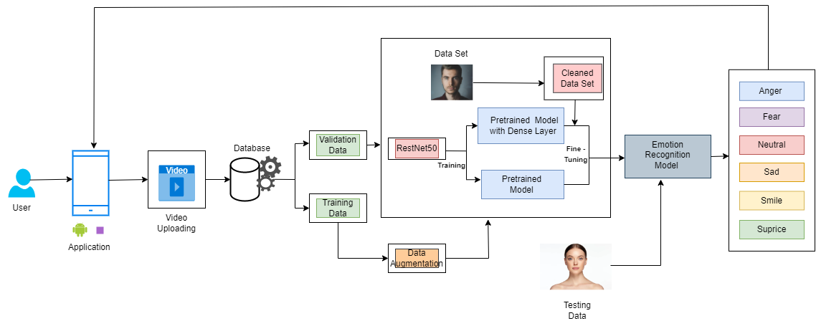
SYSTEM DIAGRAM
IT20651442 | Dilini. H.G.C
2023-24-133 | 11/3/2023

Slide 48
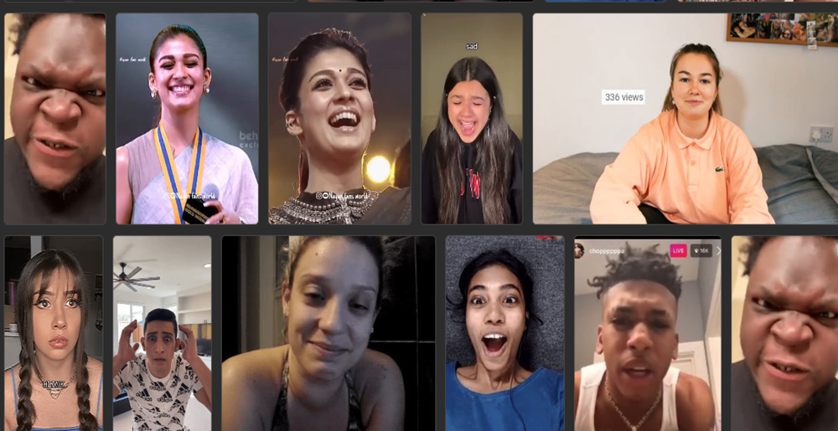
EVIDENCE OF Completion
Sub objective 01:
Implementation of a method to collect data through video call feed.
Data Gathering
All images 1818
Training set
1273 images
Validation set
545 images
1818 IMAGES
IT20651442 | Dilini. H.G.C
2023-24-133 | 11/3/2023

Slide 49
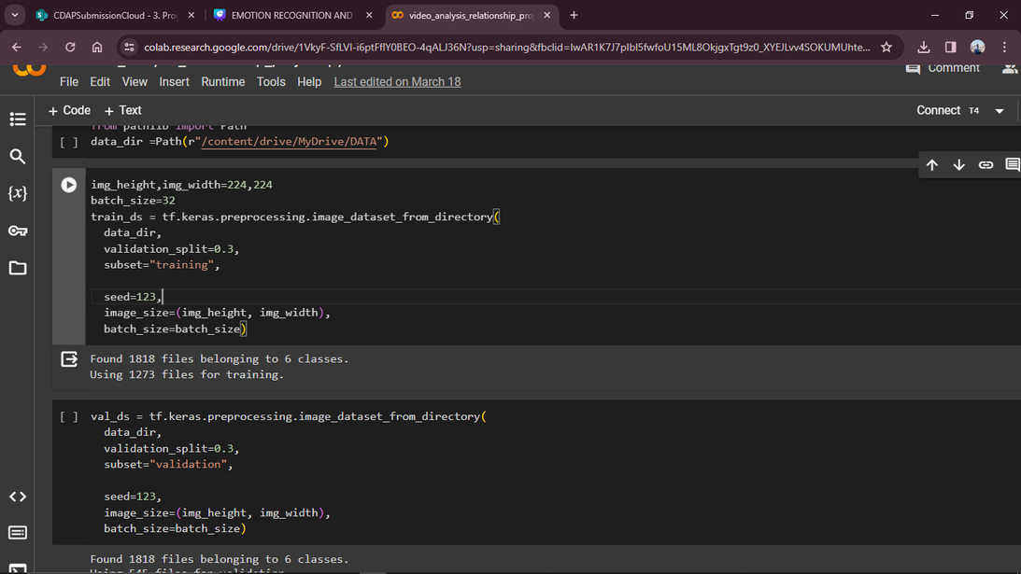
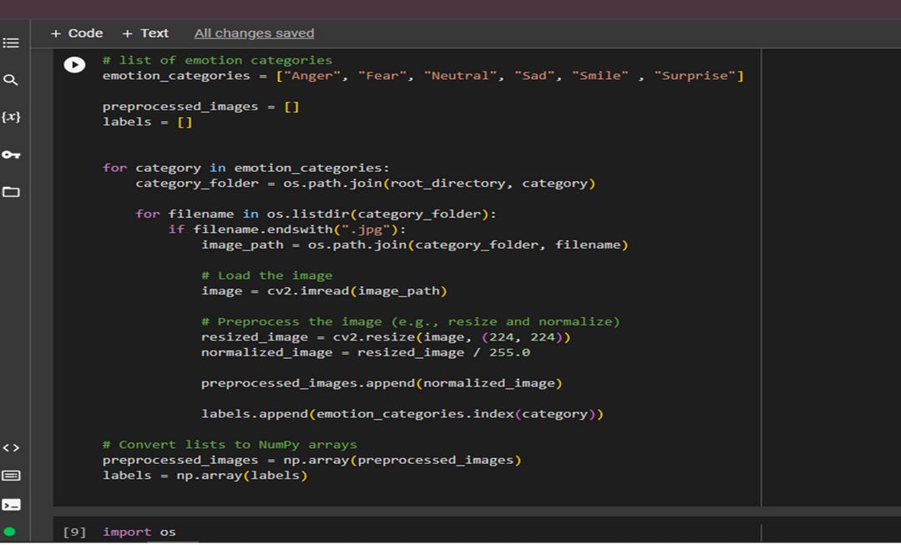
EVIDENCE OF Completion
Sub objective 01:
Implementation of a method to collect data through video call feed.
Data Preprocessing
IT20651442 | Dilini. H.G.C
2023-24-133 | 11/3/2023

Slide 50
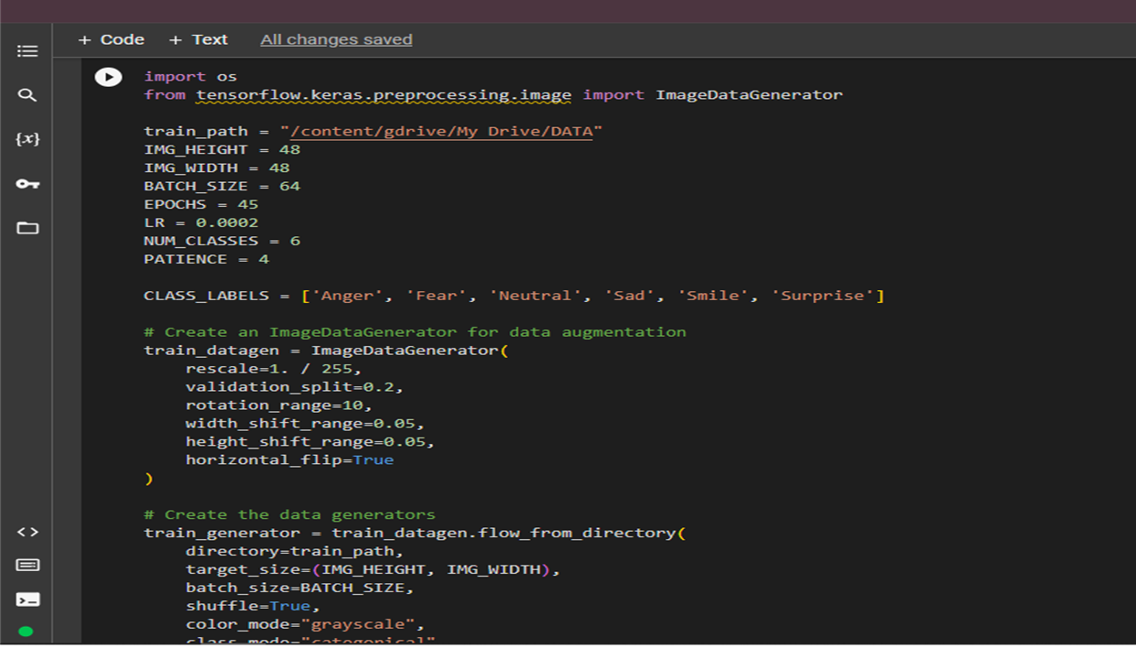
EVIDENCE OF Completion
Sub objective 01:
Implementation of a method to collect data through video call feed.
Data Augmentation
IT20651442 | Dilini. H.G.C
2023-24-133 | 11/3/2023

Slide 51
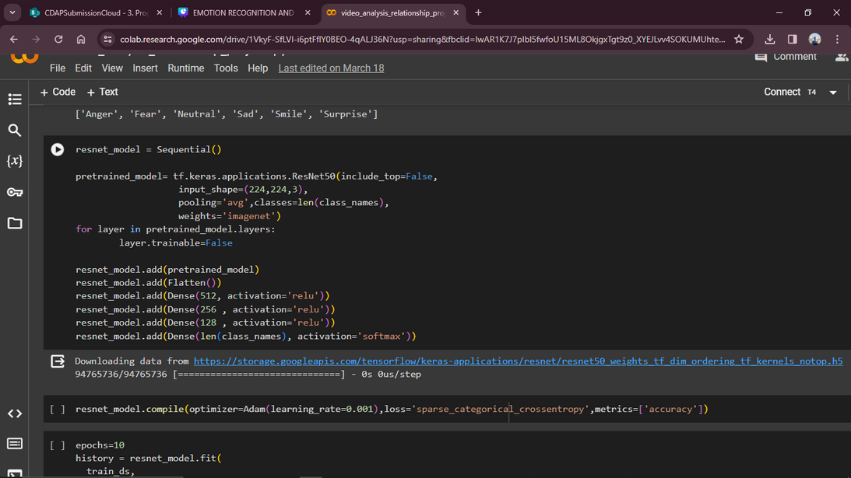
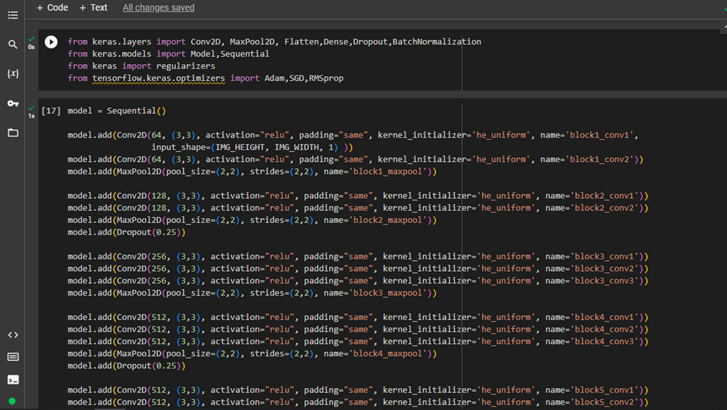
EVIDENCE OF Completion
Sub objective 02:
Develop an emotion recognition model.
Model Developing
IT20651442 | Dilini. H.G.C
2023-24-133 | 11/3/2023

Slide 52


EVIDENCE OF Completion
Sub objective 02:
Develop an emotion recognition model.
Model Training
IT20651442 | Dilini. H.G.C
2023-24-133 | 11/3/2023

Slide 53


EVIDENCE OF Completion
Sub objective 02:
Develop an emotion recognition model.
Model Evaluation
IT20651442 | Dilini. H.G.C
2023-24-133 | 11/3/2023

Slide 54
EVIDENCE OF Completion
Sub objective 03:
Train the model using the dataset.
Model Architectures
CNN Architectures Used
VGGNet16
VGGNet19
ResNet50
IT20651442 | Dilini. H.G.C
2023-24-133 | 11/3/2023

Slide 55


EVIDENCE OF Completion
Sub objective 03:
Train the model using the dataset.
Model Architectures
VGGNet16
Loss : 0.3599
Accuracy :0.8971
IT20651442 | Dilini. H.G.C
2023-24-133 | 11/3/2023

Slide 56

EVIDENCE OF Completion
Sub objective 03:
Train the model using the dataset.
Model Architectures
VGGNet19
Loss : 1.0912
Accuracy : 0.5451
IT20651442 | Dilini. H.G.C
2023-24-133 | 11/3/2023

Slide 57


EVIDENCE OF Completion
Sub objective 03:
Train the model using the dataset.
Model Architectures
ResNet-50
Loss : 0.0226
Accuracy : 0.9945
IT20651442 | Dilini. H.G.C
2023-24-133 | 11/3/2023

Slide 58
EVIDENCE OF Completion
Sub objective 03:
Train the model using the dataset.
Model Architectures
VGGNet16
Training Loss
Validation Loss
Training Accuracy
Validation Accuracy
Best Architecture is ResNet-50
Loss : 0.0226
Accuracy :0.9945
IT20651442 | Dilini. H.G.C
2023-24-133 | 11/3/2023

Slide 59

EVIDENCE OF Completion
Sub objective 03:
Train the model using the dataset.
Data Visualization for ResNet-50
IT20651442 | Dilini. H.G.C
2023-24-133 | 11/3/2023

Slide 60



EVIDENCE OF Completion
Sub objective 03:
Train the model using the dataset.
Data Visualization for VGGNet16 & ResNet-50
IT20651442 | Dilini. H.G.C
2023-24-133 | 11/3/2023

Slide 61


EVIDENCE OF Completion
Sub objective 03:
Train the model using the dataset.
Testing for VGGNet16 & ResNet-50
IT20651442 | Dilini. H.G.C
2023-24-133 | 11/3/2023

Slide 62


IT20651442 | Dilini. H.G.C
2023-24-133 | 11/3/2023

Slide 63

IT20651442 | Dilini. H.G.C
2023-24-133 | 11/3/2023

Slide 64

IT20651442 | Dilini. H.G.C
2023-24-133 | 11/3/2023

Slide 65
References.
https://www.kaggle.com/code/stpeteishii/facial-expression-classify-densenet201/notebook
https://www.kaggle.com/code/enesztrk/facial-emotion-recognition-vgg19-fer2013
https://www.kaggle.com/code/milan400/fer2013-facial-expression-detection
https://www.kaggle.com/code/sandragracenelson/emotion-recognition-using-facial-expressions
https://www.kaggle.com/code/duchieuvn/basic-emotion-recognition/notebook
IT20651442 | Dilini. H.G.C
2023-24-133 | 11/3/2023

Slide 66

DAMIDU
THIMESHA
Specialization : Cyber Security
IT20648268 | 2023-133
IT20648268 | Thimesha K.P.D.
2023-24-133 | 11/3/2023

Slide 67

BACKGROUND
Some traditions significantly impact relationships, communication styles, expectations.
The breakdown of relationships and social connections doesn't just affect individuals.
Often leading to stress, anxiety, or feelings of isolation, affecting mental well-being and overall health.
In this component we try to recognize human emotions and provide psychological support to them
IT20648268 | Thimesha K.P.D.
2023-24-133 | 11/3/2023

Slide 68


RESEARCH QUESTION
Achieving high accuracy in real-time emotion recognition
Relying on simulated emotions instead of genuine communication
Do users feel comfortable providing their voice data?
IT20648268 | Thimesha K.P.D.
2023-24-133 | 11/3/2023

Slide 69
SPECIFIC AND SUB OBJECTIVE
01
Collect data for a data set from video and audio
calls.
02
Develop an audio based emotion recognition model.
03
Train the AI model using the data set.
03
Goal tracking and emotional growth.
IT20648268 | Thimesha K.P.D.
2023-24-133 | 11/3/2023

Slide 70

SYSTEM DIAGRAM
IT20648268 | Thimesha K.P.D.
2023-24-133 | 11/3/2023

Slide 71

EVIDENCE OF Completion
Sub objective 01:
Collect data for a data set from video and audio calls.
Data Gathering
All images 1818
Training set
1152 images
Validation set
288 images
1440 IMAGES
IT20648268 | Thimesha K.P.D.
2023-24-133 | 11/3/2023

Slide 72

EVIDENCE OF Completion
Sub objective 01:
Collect data for a data set from video and audio calls.
Data Preprocessing
IT20648268 | Thimesha K.P.D.
2023-24-133 | 11/3/2023

Slide 73

EVIDENCE OF Completion
Sub objective 02:
Develop an audio based emotion recognition model.
Model Developing
IT20648268 | Thimesha K.P.D.
2023-24-133 | 11/3/2023

Slide 74


EVIDENCE OF Completion
Sub objective 02:
Develop an audio based emotion recognition model.
Model Training
IT20648268 | Thimesha K.P.D.
2023-24-133 | 11/3/2023

Slide 75
EVIDENCE OF Completion
Sub objective 03:
Train the AI model using the data set.
Model Architectures
SVC (Support Vector Classification)
ML Model
Created Deep Learning Model
IT20648268 | Thimesha K.P.D.
2023-24-133 | 11/3/2023

Slide 76


EVIDENCE OF Completion
Sub objective 03:
Train the AI model using the data set.
IT20648268 | Thimesha K.P.D.
2023-24-133 | 11/3/2023

Slide 77

IT20648268 | Thimesha K.P.D.
2023-24-133 | 11/3/2023

Slide 78


